Slide 1
Team 2 – Robot presentation
Robot Praying Mantis

Slide 2
Introduction
Hello Everyone. In this project, there were five of us in the group — Aleksis, Gabriel, Hannah, Arjun, and Emre. We structured the project into five sprints using an Agile Scrum framework, with each of us leading a different phase — design, manufacturing, assembly, electrical and coding, and testing.
Our robot was inspired by the praying mantis, which turned out to be a natural fit for the brief. The mantis naturally walks, avoids obstacles, is attracted to light, and spreads its wings when threatened — mapping almost perfectly onto our four tasks.

Slide 3
The Team
During this project, we had decided to design our robot in the style of a praying mantis, as we believed this would match the brief perfectly.
In doing so, we had divided the work equally and equitably. How we did this is look at past skills and current skills to see who are the best matches to the task, then we divided the sprints in accordance to the team’s strengths.
Aleksis – Design scrum leader
Gabriel– Manufacturing scrum leader
Hannah – Assembly scrum leader
Arjun – Electrical/coding scrum leader
Emre – Testing scrum leader

Slide 4
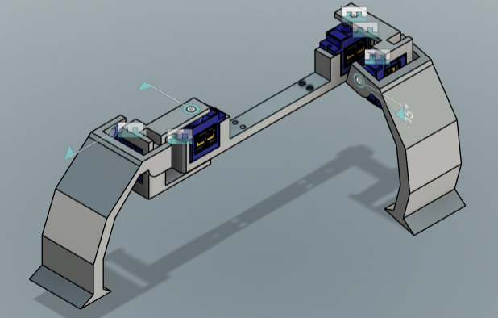
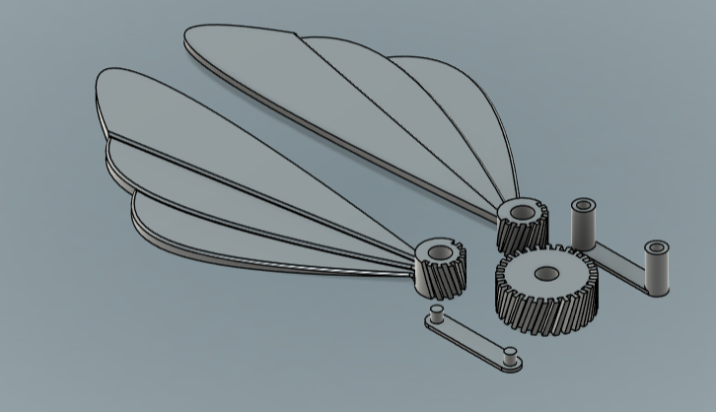
Sprint one – Design sprint
During the design sprint, all components were modelled in Fusion 360. Emre designed the legs, Aleksis the wings, Gabriel the arms, Hannah the neck and chassis frame, and Arjun the base.
Leader of the Sprint: Aleksis
Legs: Emre designed the legs as a pair of arched structures housing the servo motors responsible for driving the robot's movement. Their curved form was directly inspired by the mantis, giving the robot a natural, insect-like stance while providing the structural support needed to carry the full assembly.
Figure.1: Legs
Wings: Aleksis designed the wings as a fan-like blade assembly driven by a gear mechanism, allowing them to spread open during the predator response task. The layered blade design mimics the real mantis wing structure, ensuring the movement looked realistic while remaining mechanically achievable within our manufacturing constraints.
Figure.2 Wings

Slide 5
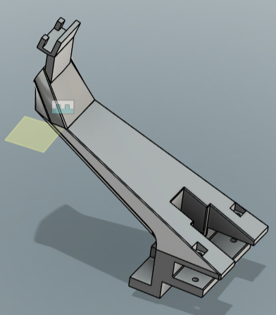
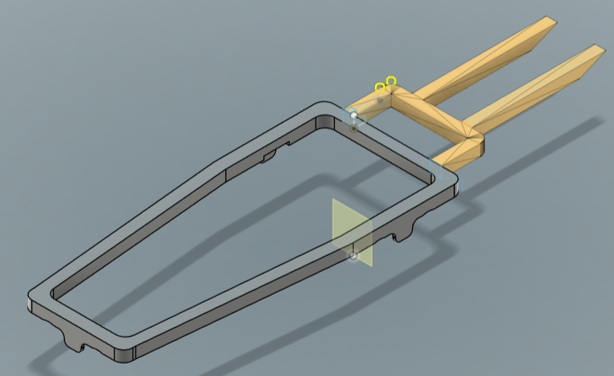
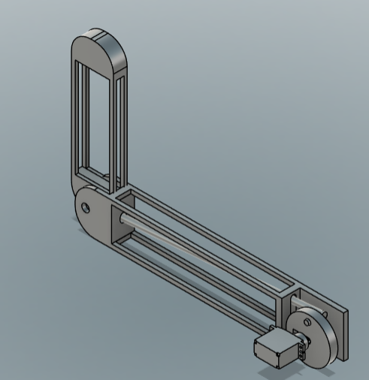
Sprint 1 – Design - Continue
Arms: Gabriel designed the arms as an L-shaped linkage with a servo at the joint, replicating the mantis's iconic raised forelimb posture. The lightweight frame structure keeps the weight down while still providing enough rigidity to hold its position reliably during operation.
Figure.4: Frame
Figure.5: Neck
Neck: Hannah designed the neck as an angled mount to correctly position the robot's head and sensors. Its angular, sloped geometry was carefully considered to ensure the sensors faced forward at the right angle, giving the robot the best possible field of view for object detection and light tracking.
Chassis Frame: Hannah also designed both parts of the chassis frame — a rectangular outer frame to house the electronics, and an internal H-shaped support structure. Together they provide a rigid skeleton for the robot, keeping all components securely in place while allowing easy access during assembly and testing
Figure.3: Arms

Slide 6
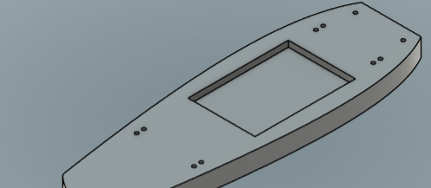
Sprint 1 – Design - Continue
Base: Arjun designed the base as a smooth, elongated plate with evenly distributed mounting points around its edges. Its streamlined shape ties all the components together into one unified assembly, while the central cutout and fixing holes ensure clean cable routing and secure attachment of the electronics underneath.
Figure.6 Base chasis
Design Sprint Reflection:
Overall, despite facing some external setbacks outside of the team's control, we felt the design sprint went really well. Every component was completed to a good standard and the team communicated effectively throughout. Had those setbacks not occurred, we're confident the sprint would have been delivered comfortably on time.
Design Sprint Evaluation
Overall the designed parts were of a good standard and closely matched the original specification. Some components did require minor adjustments further down the line during assembly and testing, however this is fairly normal in any engineering project. Outside of those tweaks, the parts produced during the design sprint provided a solid foundation that met the brief effectively.

Slide 31
Thank you

